Slide 1
Architecture of Enterprise Applications 17 Log-Structured Database & Vector Database
Haopeng Chen
REliable, INtelligent and Scalable Systems Group (REINS)
Shanghai Jiao Tong University
Shanghai, China
http://reins.se.sjtu.edu.cn/~chenhp
e-mail: chen-hp@sjtu.edu.cn

Slide 2
Contents and Objectives
Contents
KV数据结构
LSTM树与SSTable
日志结构数据库
LevelDB & RocksDB
HTAP混合存储
Vector数据库
Objectives
能够根据数据特性和数据访问模式，识别适合日志数据库和向量数据库存储的数据，设计并实现其在日志数据库和向量数据库中的存储和访问方案

Slide 3
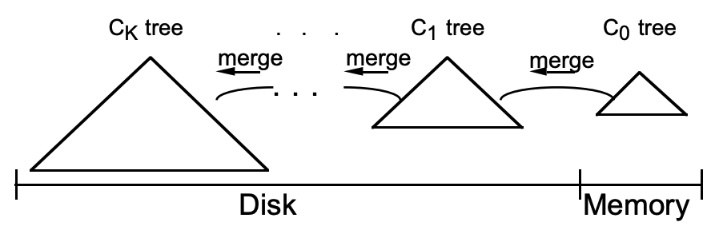
LSM-Tree: Log-Structured Merge Tree
LSM-Tree：Log-Structured Merge Tree
是一种分层、有序、面向磁盘的数据结构，其核心思想是充分利用磁盘批量顺序写性能远高于随机写性能的特点
Log需要提高写入性能
Log以Append的模式追加写入，不存在删除和修改
这种结构虽然大大提升了数据的写入能力，却是以牺牲部分读取性能为代价，故此这种结构通常适合于写多读少的场景
C0 树（常驻内存）
C1-N 树(位于磁盘)

Slide 4
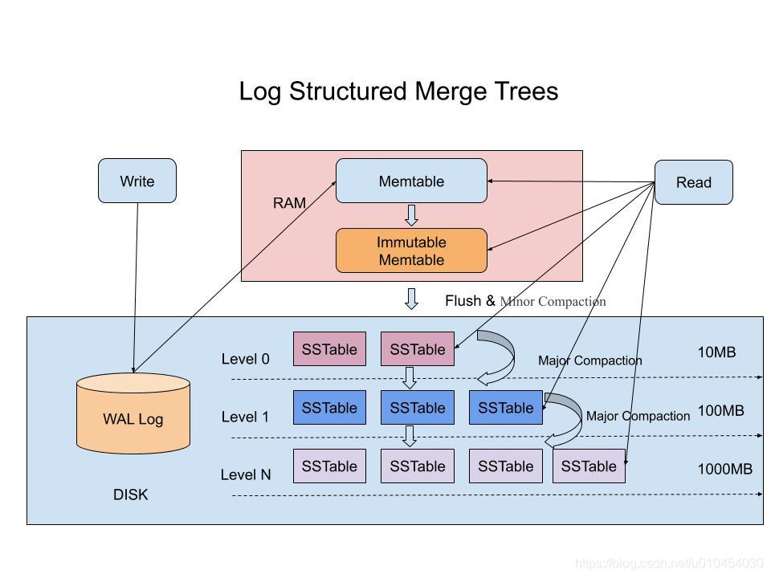
LSMT

Slide 5
LSMT
优点
大幅度提高插入（修改、删除）性能
空间放大率降低
访问新数据更快，适合时序、实时存储
数据热度分布和level相关
缺点
牺牲了读性能（一次可能访问多个层）
读、写放大率提升

Slide 6
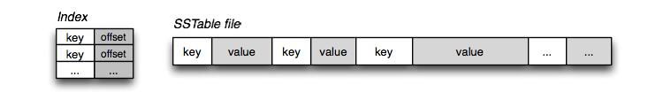
SSTable
SSTable : Sorted String Table
SSTable的特点
存储的是<键,值>格式的字节数据
字节数据的长度随意，没有限制
数据顺序写入
键可以重复，键值对不需要对齐
随机读取操作非常高效
SSTable的限制
一旦SSTable写入硬盘后，就是不可变的，因为插入或者删除需要对SSTable文件进行大量的I/O操作
不适合随机读取和写入，因为效率很低，原因同上一条

Slide 7
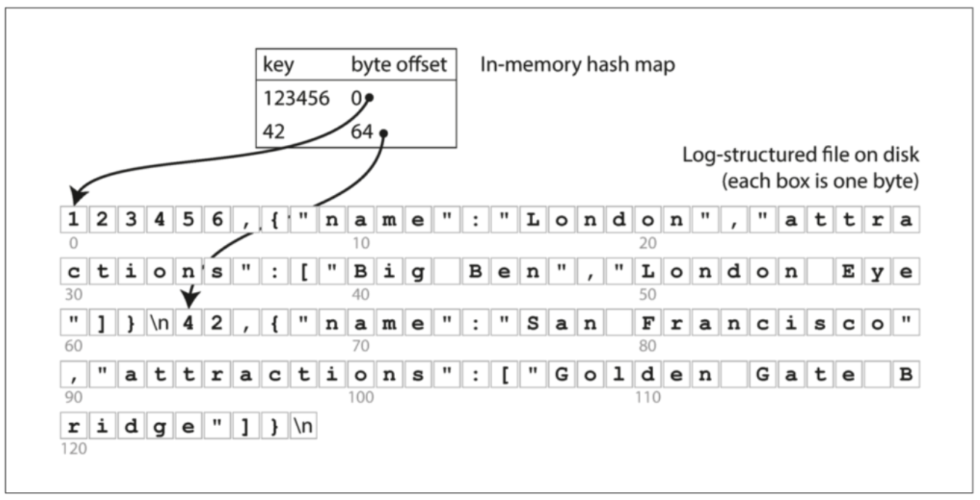
SSTable
SSTable : Sorted String Table

Slide 8
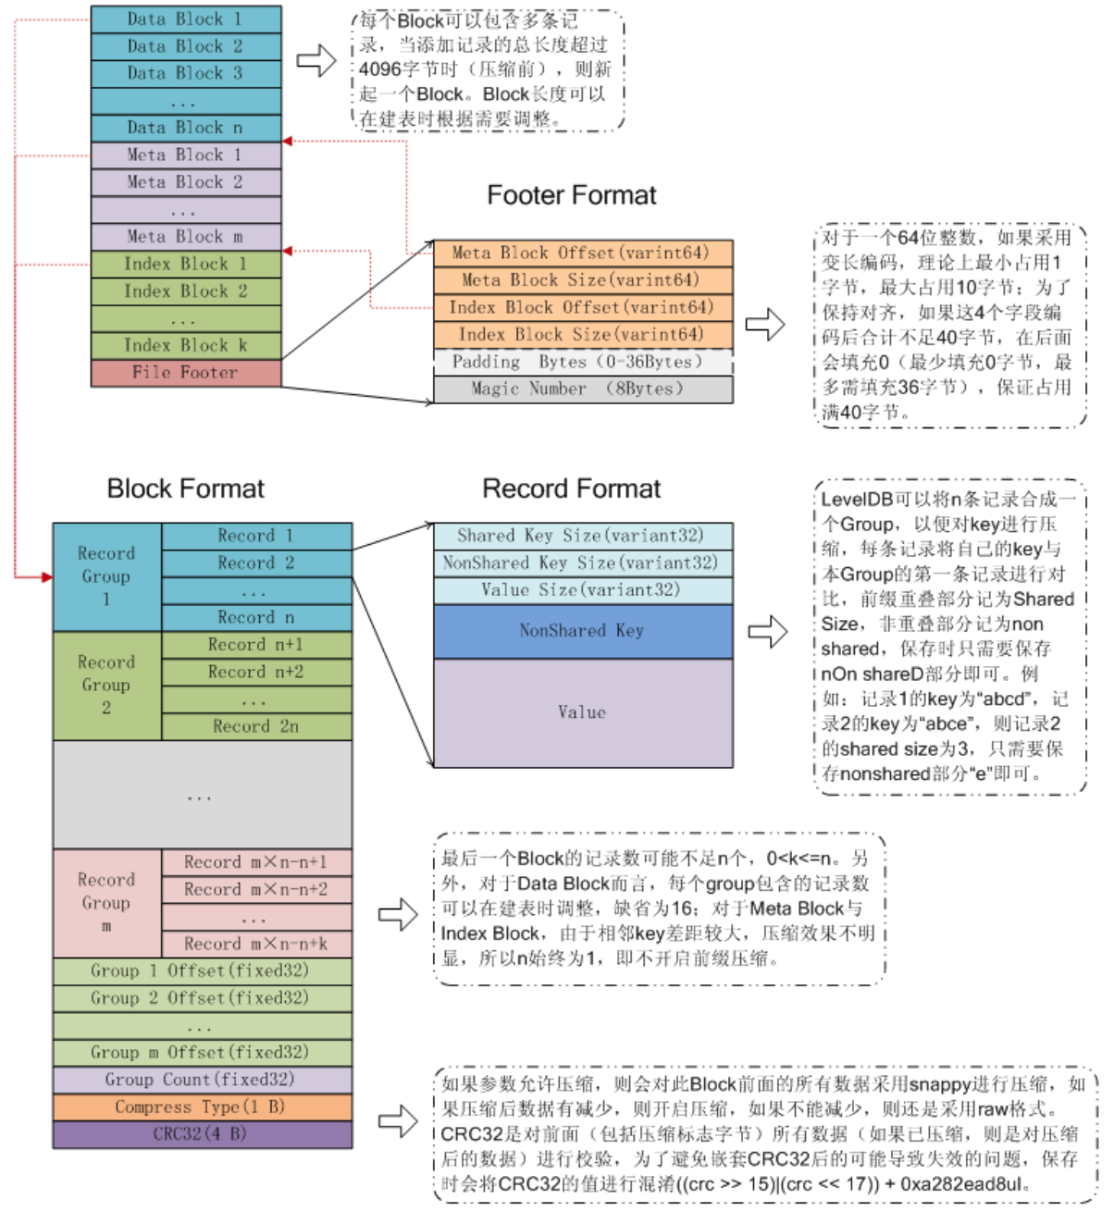
SSTable

Slide 9
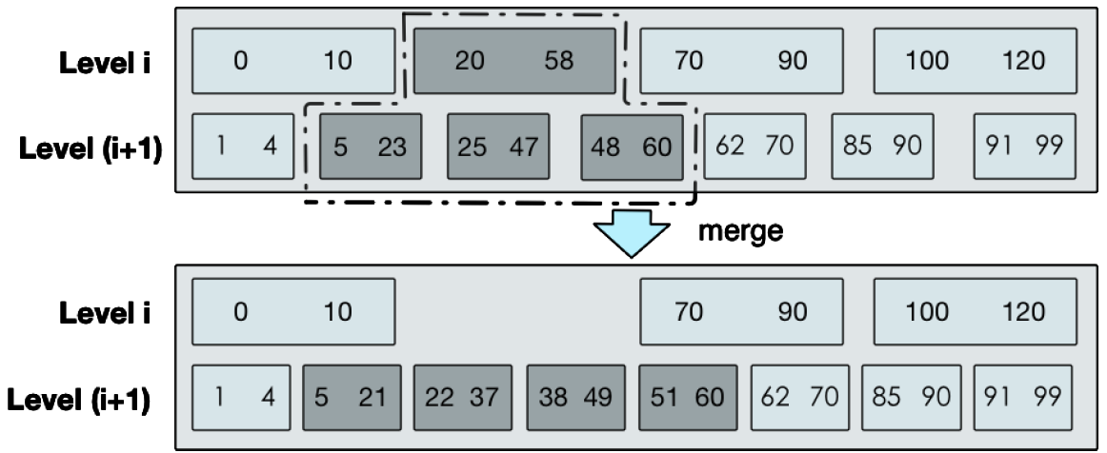
LevelDB
Compaction

Slide 10
LevelDB
Compaction

Slide 11

RocksDB
RocksDB is an embeddable persistent key-value store for fast storage
RocksDB uses a log structured database engine, written entirely in C++, for maximum performance. Keys and values are just arbitrarily-sized byte streams.
RocksDB is developed and maintained by Facebook Database Engineering Team. It is built on earlier work on LevelDB by Sanjay Ghemawat (sanjay@google.com) and Jeff Dean (jeff@google.com)
https://rocksdb.org/
https://rocksdb.org.cn/doc.html
https://github.com/facebook/rocksdb/
https://github.com/facebook/rocksdb/wiki/RocksDB-Overview

Slide 12
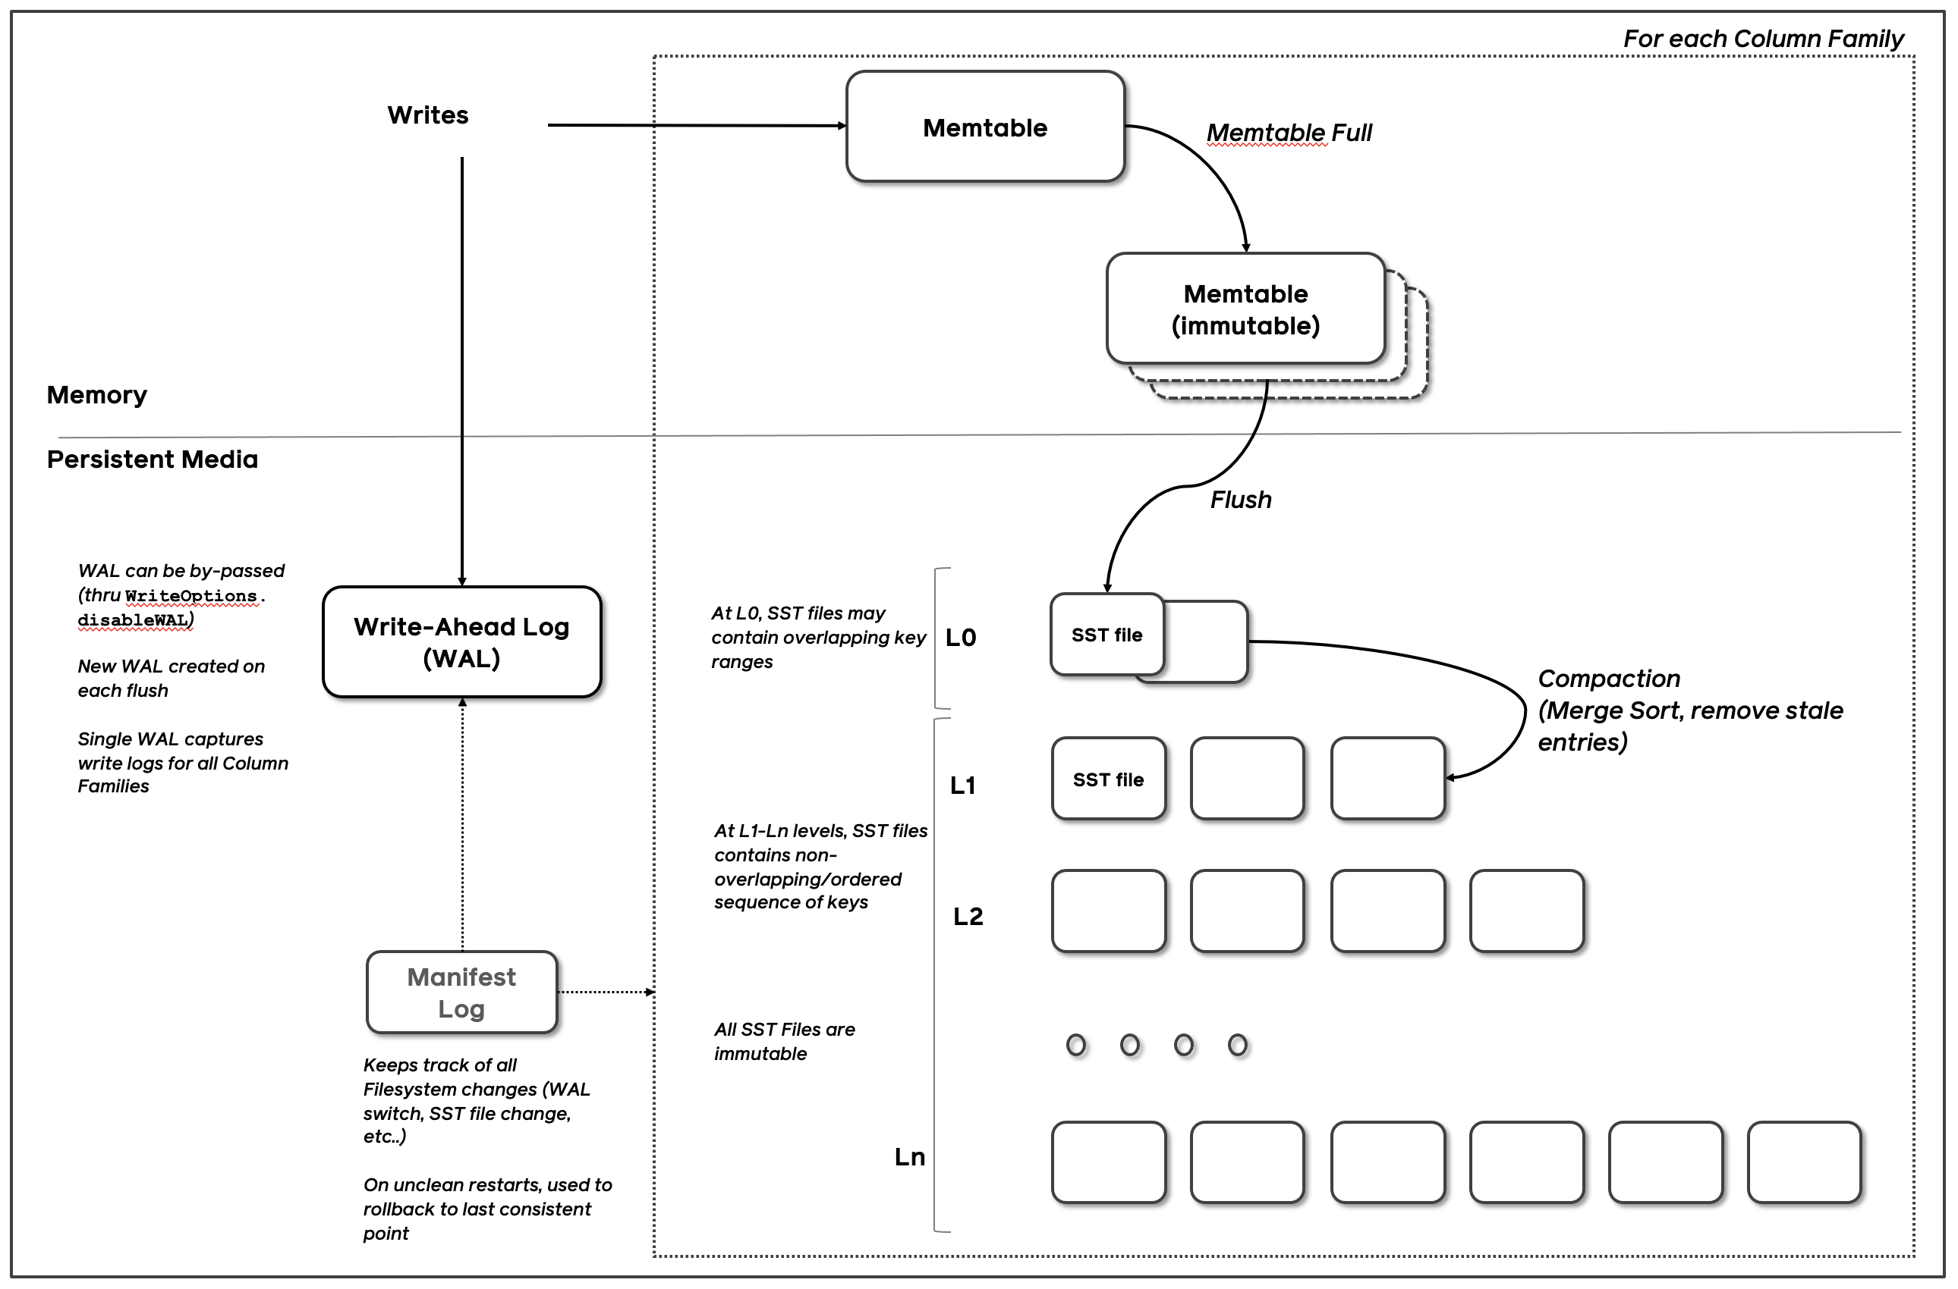
High Level Architecture

Slide 13
Rocksdb Example
RocksDBRepository.java
@Slf4j @Repository public class RocksDBRepository implements
KVRepository<String, Object> { private final static String FILE_NAME
= "spring-boot-db"; File baseDir; RocksDB db;
KVRepository.java
import java.util.Optional; public interface KVRepository<K, V> { boolean save(K key, V value); Optional<V> find(K key); boolean delete(K key); }

Slide 14
Rocksdb Example
@PostConstruct // execute after the application starts. void initialize() { RocksDB.loadLibrary(); final Options options = new Options(); options.setCreateIfMissing(true); baseDir = new File("/tmp/rocks", FILE_NAME); try { Files.createDirectories(baseDir.getParentFile().toPath()); Files.createDirectories(baseDir.getAbsoluteFile().toPath()); db = RocksDB.open(options, baseDir.getAbsolutePath()); log.info("RocksDB initialized"); } catch(IOException | RocksDBException e) { log.error("Error initializng RocksDB. Exception: '{}', message: '{}’”,
e.getCause(), e.getMessage(), e); } }
@Override public synchronized boolean save(String key, Object value) { log.info("saving value '{}' with key '{}'", value, key); try { db.put(key.getBytes(), SerializationUtils.serialize(value)); } catch (RocksDBException e) { log.error("Error saving entry. Cause: '{}', message: '{}'", e.getCause(), e.getMessage()); return false; } return true; }

Slide 15
Rocksdb Example
@Override public synchronized Optional<Object> find(String key) { Object value = null; try { byte[] bytes = db.get(key.getBytes()); if (bytes != null) value = SerializationUtils.deserialize(bytes); } catch (RocksDBException e) { log.error( "Error retrieving the entry with key: {}, cause: {}, message: {}", key, e.getCause(), e.getMessage() ); } log.info("finding key '{}' returns '{}'", key, value); return value != null ? Optional.of(value) : Optional.empty(); }
@Override public synchronized boolean delete(String key) { log.info("deleting key '{}'", key); try { db.delete(key.getBytes()); } catch (RocksDBException e) { log.error("Error deleting entry, cause: '{}', message: '{}’”,
e.getCause(), e.getMessage()); return false; } return true; } }

Slide 16
Rocksdb Example
Api.java
@Slf4j @RestController @RequestMapping("/api") public class Api { private final KVRepository<String, Object> repository; public Api(KVRepository<String, Object> repository) { this.repository = repository; } // curl -iv -X POST -H "Content-Type: application/json" -d '{"bar":"baz"}' http://localhost:8080/api/foo @PostMapping(value = "/{key}", consumes = MediaType.APPLICATION_JSON_VALUE, produces = MediaType.APPLICATION_JSON_VALUE) public ResponseEntity<Object> save(@PathVariable("key") String key, @RequestBody Object value) { return repository.save(key, value) ? ResponseEntity.ok(value) : ResponseEntity.status(HttpStatus.INTERNAL_SERVER_ERROR).build(); }

Slide 17
Rocksdb Example
Api.java
// curl -iv -X GET -H "Content-Type: application/json" http://localhost:8080/api/foo @GetMapping(value = "/{key}", produces = MediaType.APPLICATION_JSON_VALUE) public ResponseEntity<Object> find(@PathVariable("key") String key) { return ResponseEntity.of(repository.find(key)); } // curl -iv -X DELETE -H "Content-Type: application/json" http://localhost:8080/api/foo @DeleteMapping(value = "/{key}", produces = MediaType.APPLICATION_JSON_VALUE) public ResponseEntity<Object> delete(@PathVariable("key") String key) { return repository.delete(key) ? ResponseEntity.noContent().build() : ResponseEntity.status(HttpStatus.INTERNAL_SERVER_ERROR).build(); } }

Slide 18
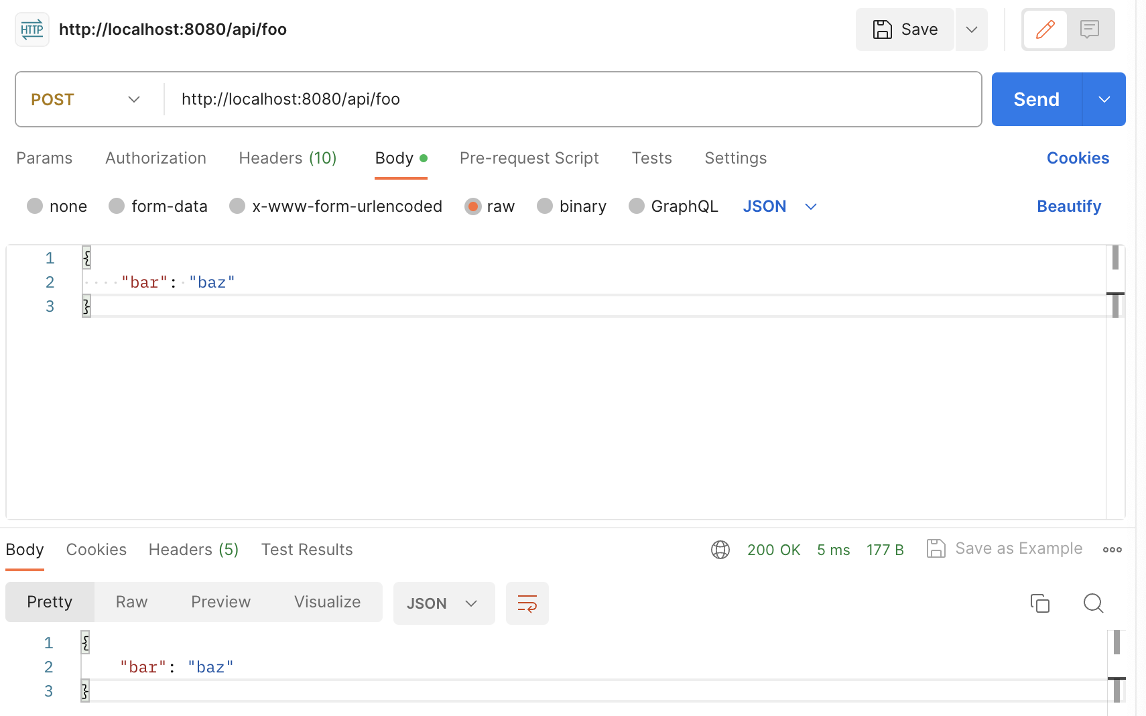
Rocksdb Example

Slide 19



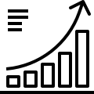
HTAP
Hybrid Transactional/Analytical Processing
混合事务分析处理
Online Transaction Processing(OLTP)
在线事务处理
低延迟
高并发
数据量小
Online Analytical Processing(OLAP)
在线分析处理
高延迟
低并发
大量数据
Notes:
现在数据库不仅仅需要MYSQL

Slide 20


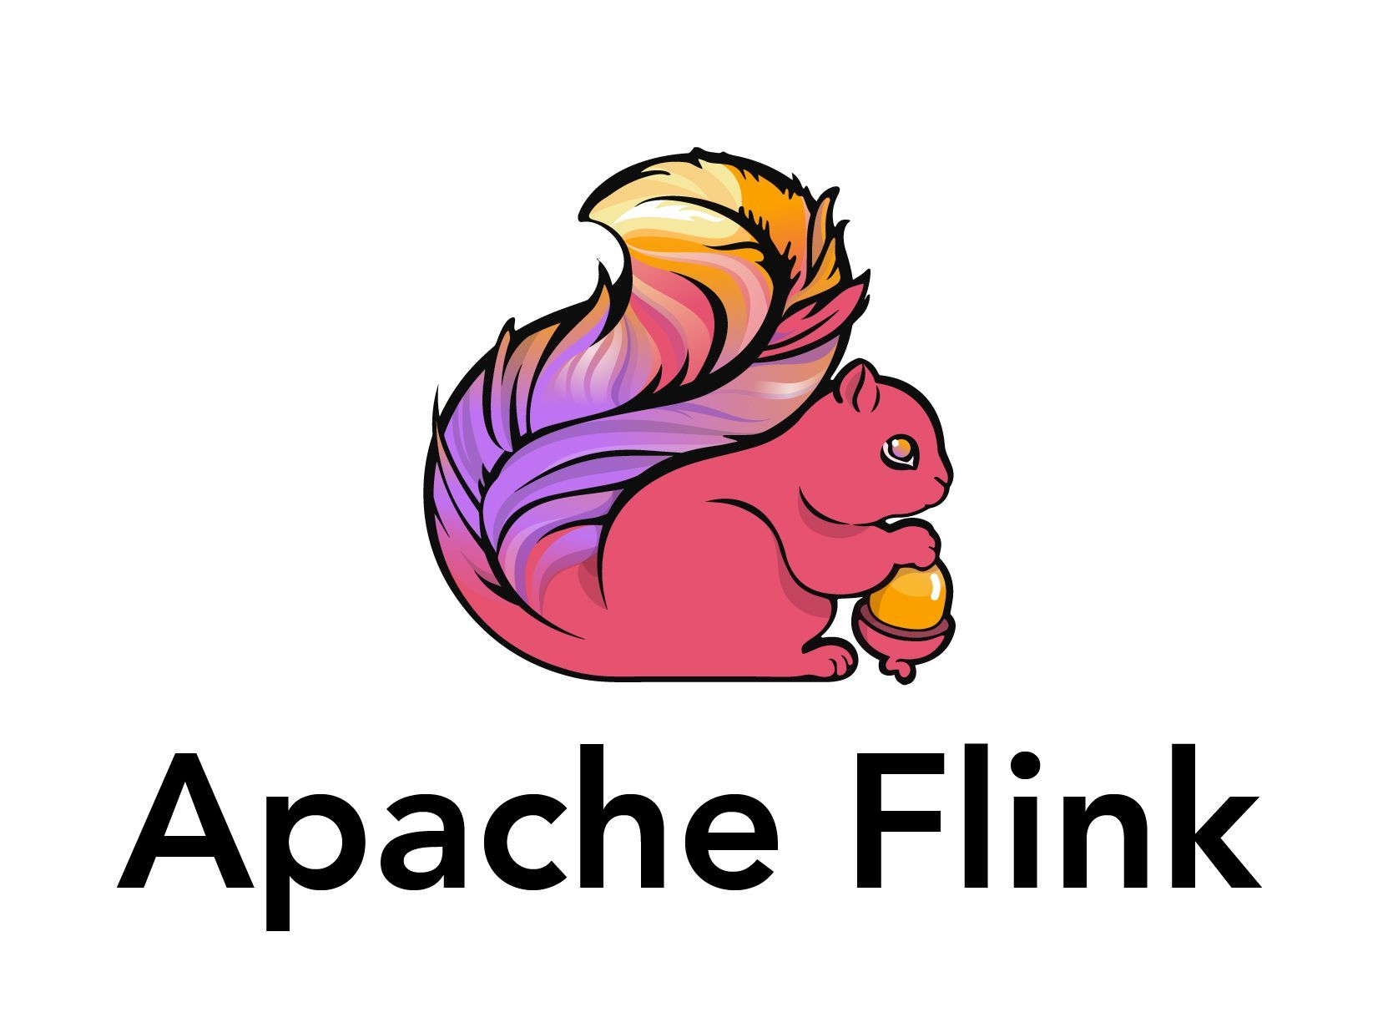


LSM-TREE
LSM-Tree 抽象结构
- 分层结构
提供写优化
TP事务友好
RocksDB由Facebook开发，是LSM-Tree数据结构的最成熟实现，越来越多地在主流数据库中作为新的底层存储引擎
Notes:
LSM Tree是一种相对比较新的数据结构图示， 其高度分层

Slide 21
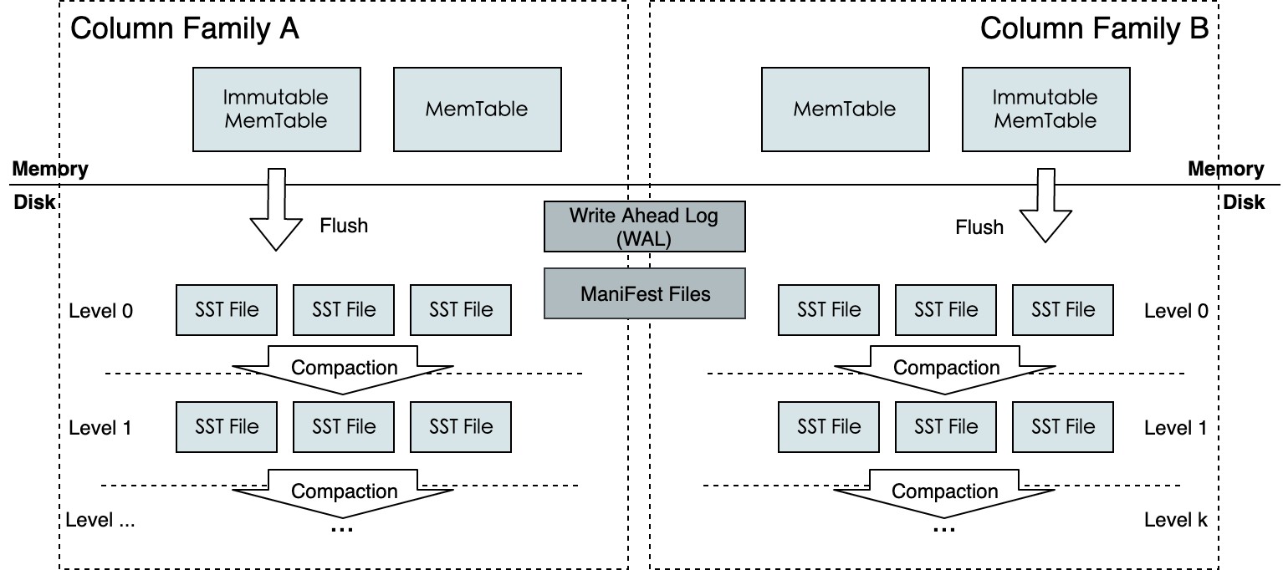
LSM-TREE
LSM-Tree 抽象结构
- 分层结构
提供写优化
TP事务友好
RocksDB静态结构
Notes:
LSM Tree是一种相对比较新的数据结构图示， 其高度分层

Slide 22
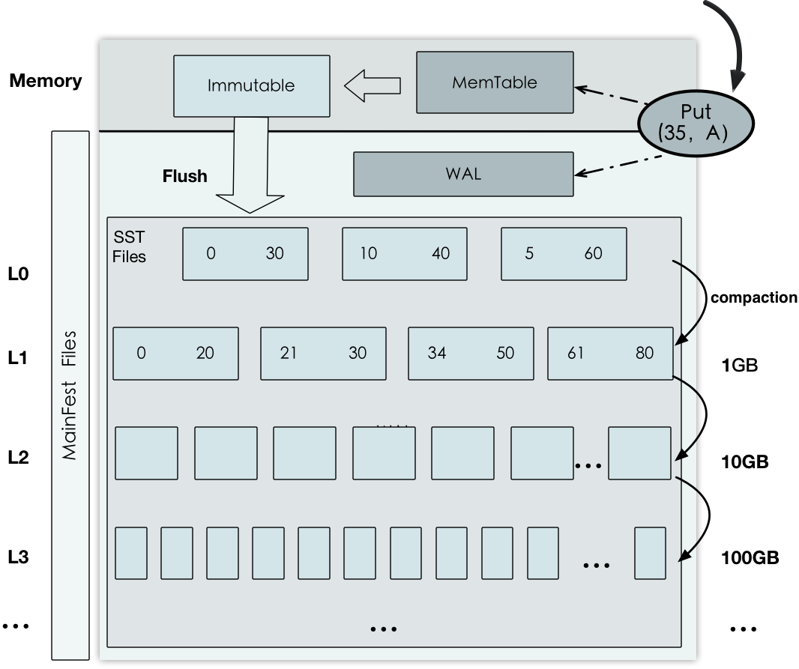
LSM-TREE写阻塞问题
RocksDB写流程
优 - 低延迟插入
写入内存后直接返回
后台异步写入磁盘
劣 - 写阻塞问题
L0层满时将阻塞内存到磁盘的Flush过程
L0层下沉Compaction过程无法多任务执行
异步写写放大严重，容易磁盘变成瓶颈
降低了TP事务的可用性

Slide 23
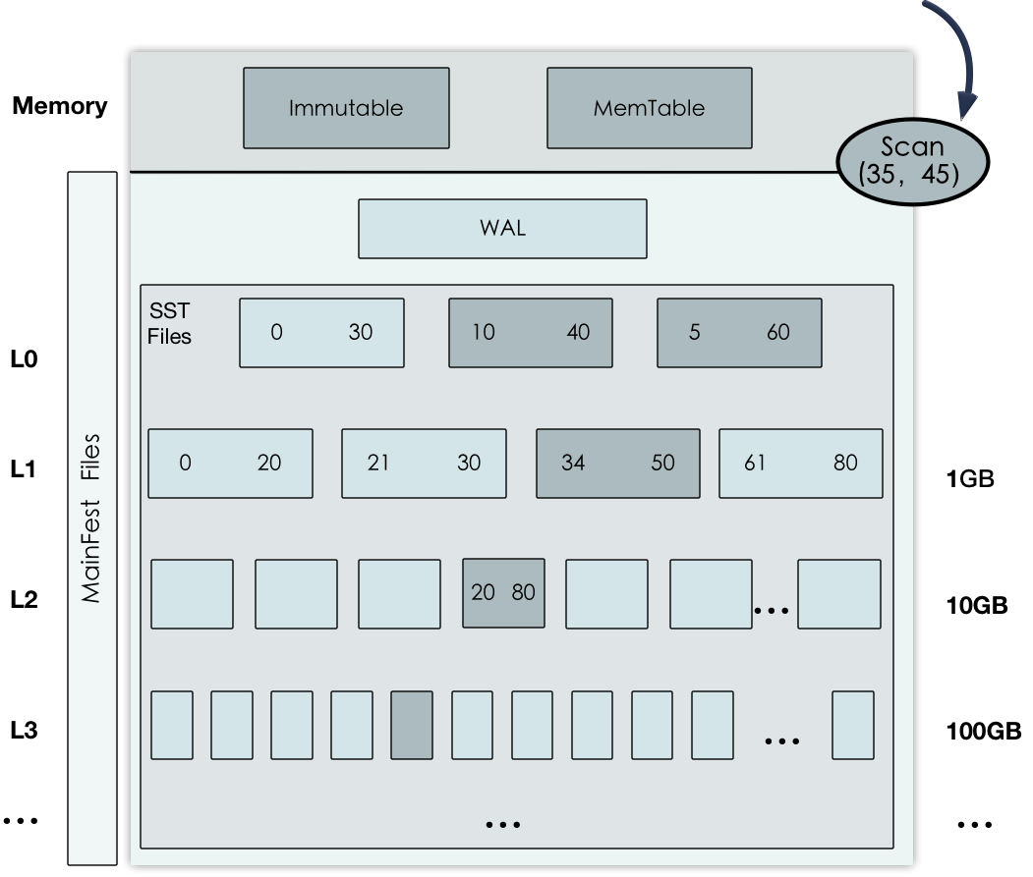
背景与问题 - LSM-TREE读放大问题
RocksDB读流程
劣 - 读放大问题
不同层级存储着不同版本的数据
需要访问所有可能的数据文件
限制了AP查询的性能

Slide 24
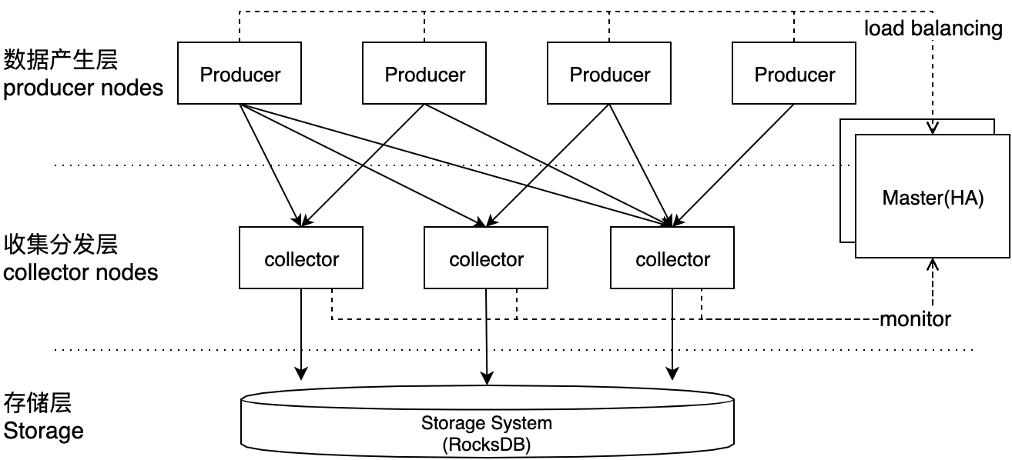
设计与实现 – 解决写阻塞问题
在RocksDB和数据源之间增加一个收集分发层，集群结构如下
写阻塞时缓存数据

Slide 25
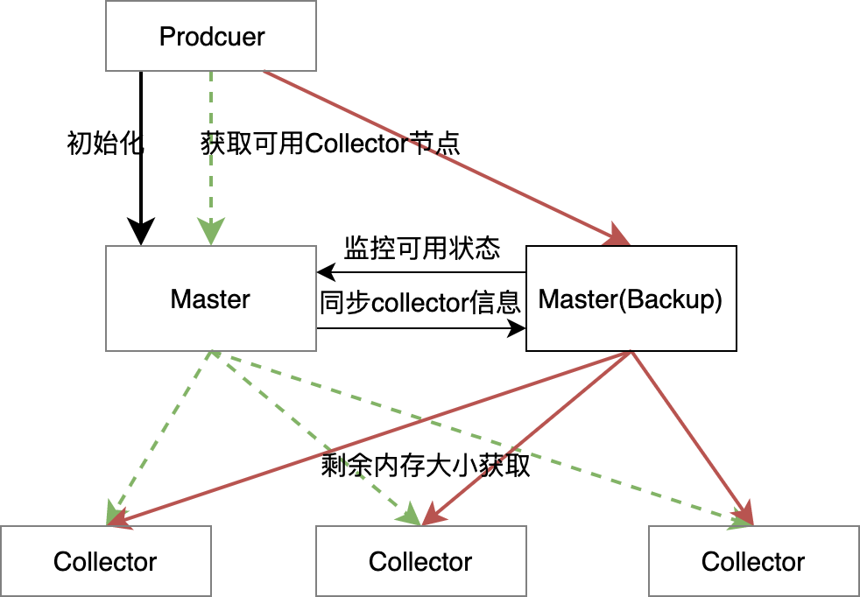
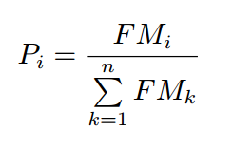
解决写阻塞问题
采用中心化设计：
Master采用主从备份
监控集群负载，
调控负载均衡。
负载均衡策略基于剩余内存大小，
即分配到某个节点的概率与剩余内存大小正比
P_{i} : 流量分配到节点i的概率
FM_{i} : 节点剩余内存

Slide 26
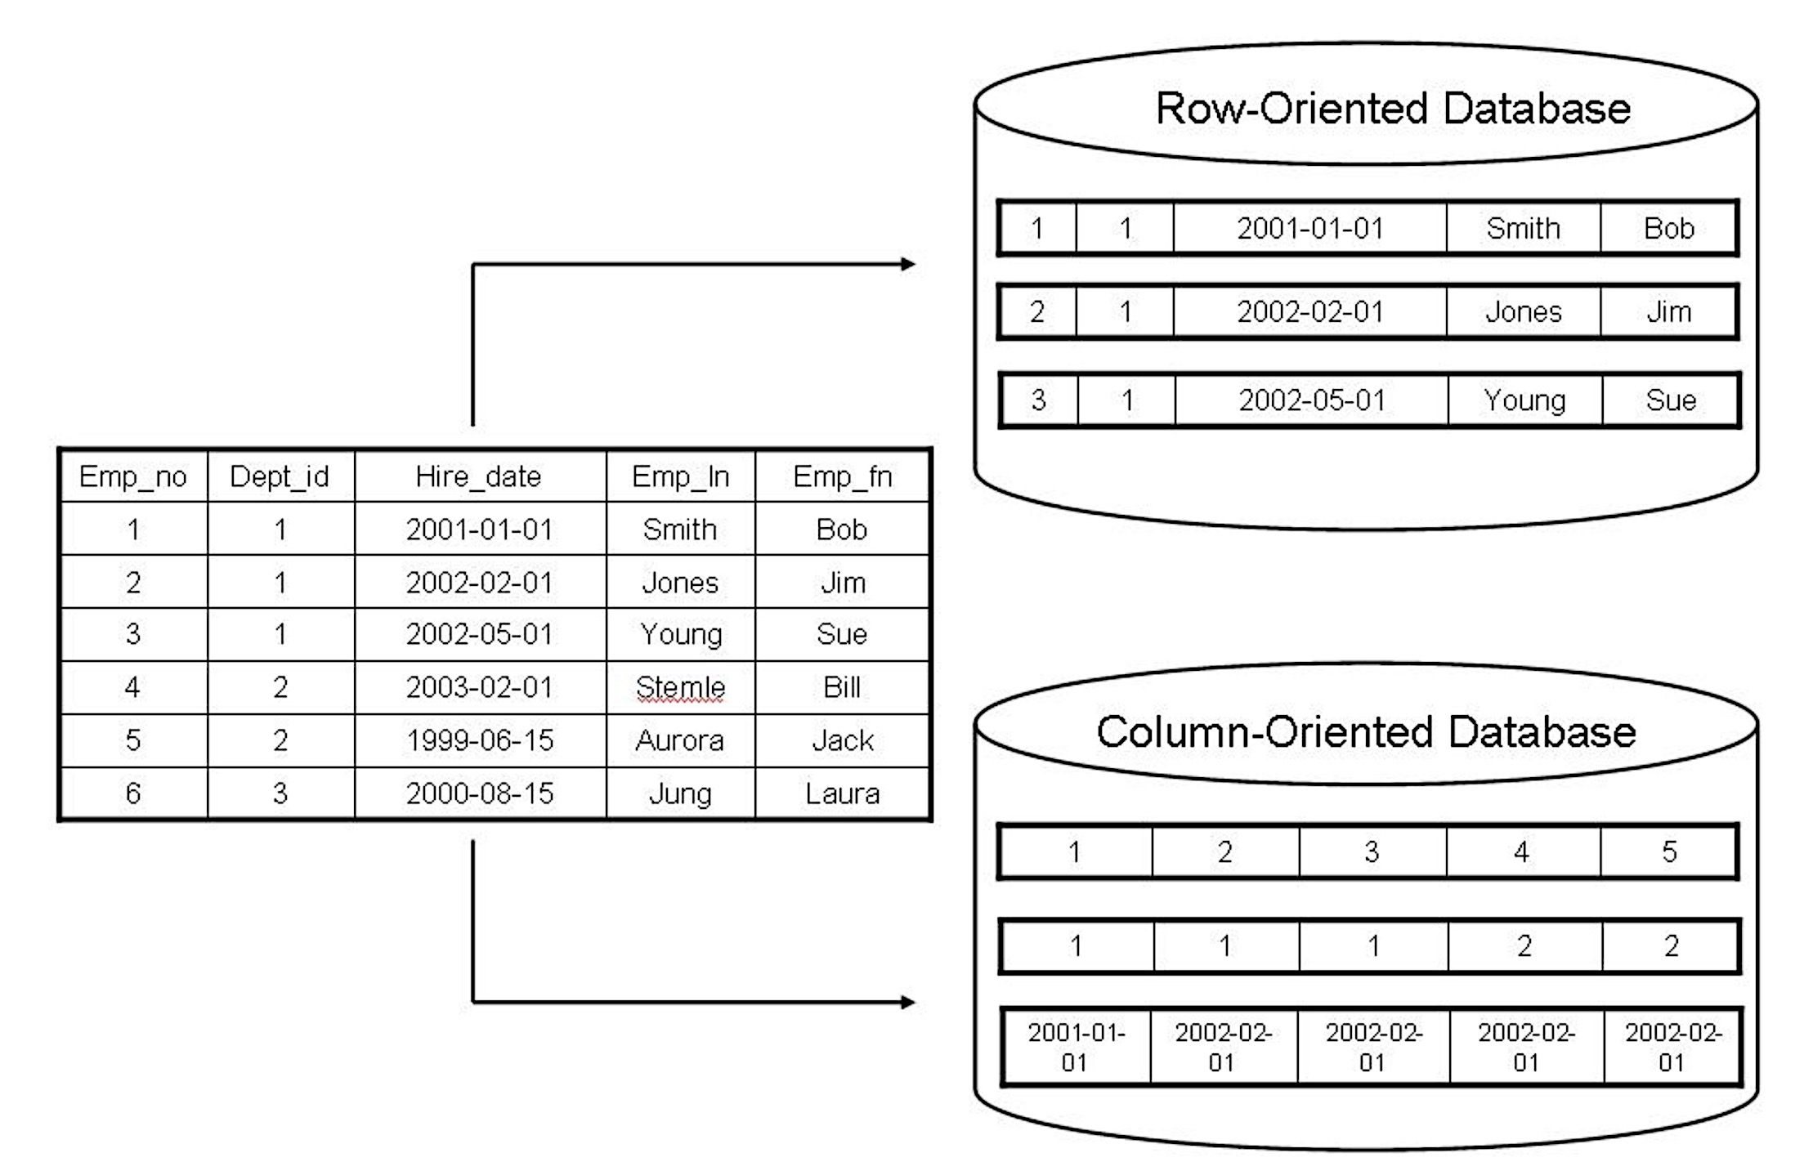
解决读放大问题
在RocksDB中增加列式存储
列式存储在访问少量列时磁盘读取量更小，可以减少读放大的开销
行式存储(原)
适合事务处理(TP)
数据写入不需要 拆分属性
列式存储(新增)
适合分析处理(AP)
便于分类压缩
对内存友好

Slide 27
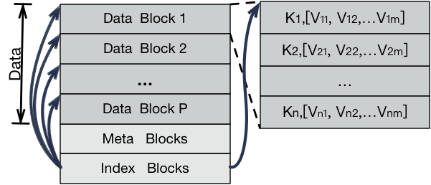
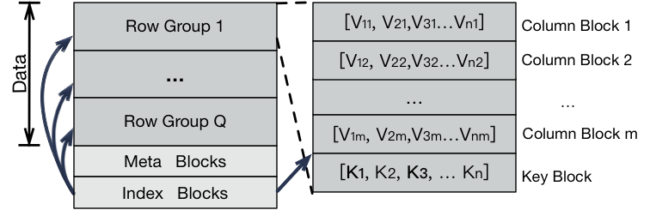
解决读放大问题
在RocksDB中增加列式存储
列式存储在访问少量列时磁盘读取量更小，可以减少读放大的开销
行式存储(原)
适合事务处理(TP)
数据写入不需要 拆分属性
列式存储(新增)
适合分析处理(AP)
便于分类压缩
对内存友好

Slide 28
解决读放大问题
提出混合存储策略
=>常做事务的数据以行式存储，
=>常做查询的数据以列式存储
以磁盘读写开销为格式转换的指标
以文件为格式调整粒度
额外记录每个文件的历史操作
计算每个文件在行式存储和列式存储下重做历史操作时的磁盘读写次数
兼容原有的后台逻辑
新增主动的conversion后台过程 监控所有文件，当满足【原格式读代价 > 新格式读代价 + 新格式写代价】条件，就触发原地格式转换
结合原有的compaction过程 新文件产生时，根据祖先文件，选取读写代价总和最小的格式

Slide 29
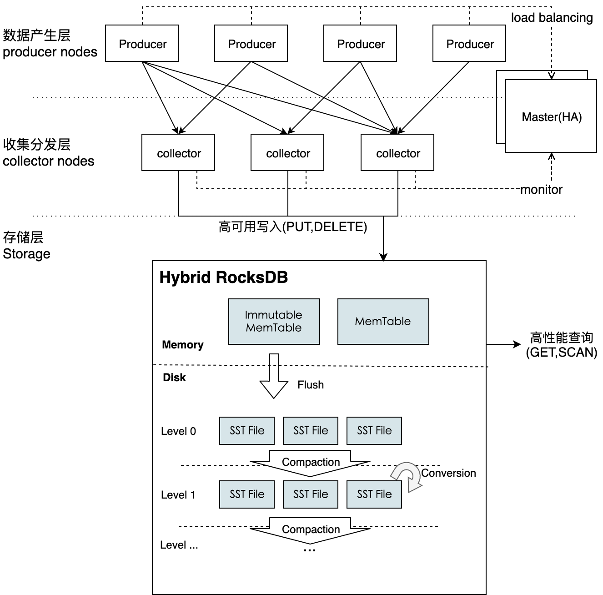
HTAP系统整合
TP
可用性
AP性能优化
Notes:
创新点，分四方面

Slide 30
技术路线
目标：使基于LSM-Tree的数据库（以RocksDB为例）能高效地处理HTAP请求
方法总结
解决写阻塞
可用性保证TP
解决读放大
优化AP性能
中间层缓存数据
负载均衡
新列存结构
在线混合存储决策
后续工作
负载策略再优化
机器学习估算代价
上层数据库对接
Notes:
创新点，分四方面

Slide 31
References
O’Neil P, Cheng E, Gawlick D, et al. The log-structured merge-tree (LSM-tree)[J]. Acta Informatica, 1996, 33: 351-385.
https://www.cs.umb.edu/~poneil/lsmtree.pdf
SSTables and LSM Trees
https://rahulpradeep.medium.com/sstables-and-lsm-trees-5ba6c5529325
RocksDb中文网
https://rocksdb.org.cn
LevelDB详解
https://blog.csdn.net/linuxheik/article/details/52768223
Rocksdb源码剖析一----Rocksdb概述与基本组件
https://blog.csdn.net/flyqwang/article/details/50096377
leveldb - sstable格式
https://www.cnblogs.com/cobbliu/p/6194072.html

Slide 32
References
日志结构的合并树 The Log-Structured Merge-Tree
https://www.cnblogs.com/siegfang/archive/2013/01/12/lsm-tree.html
LSM-tree 基本原理及应用
https://cloud.tencent.com/developer/news/340271
深入理解什么是LSM-Tree
https://blog.csdn.net/u010454030/article/details/90414063
B+ Tree、LSM、Fractal tree index 读写放大分析
http://kernelmaker.github.io/Btree_LSM_FTI
Data structures for external memory
http://blog.omega-prime.co.uk/2016/07/05/datastructures-for-external-memory/
rocksdb-example
https://github.com/ukchukx/rocksdb-example

Slide 33
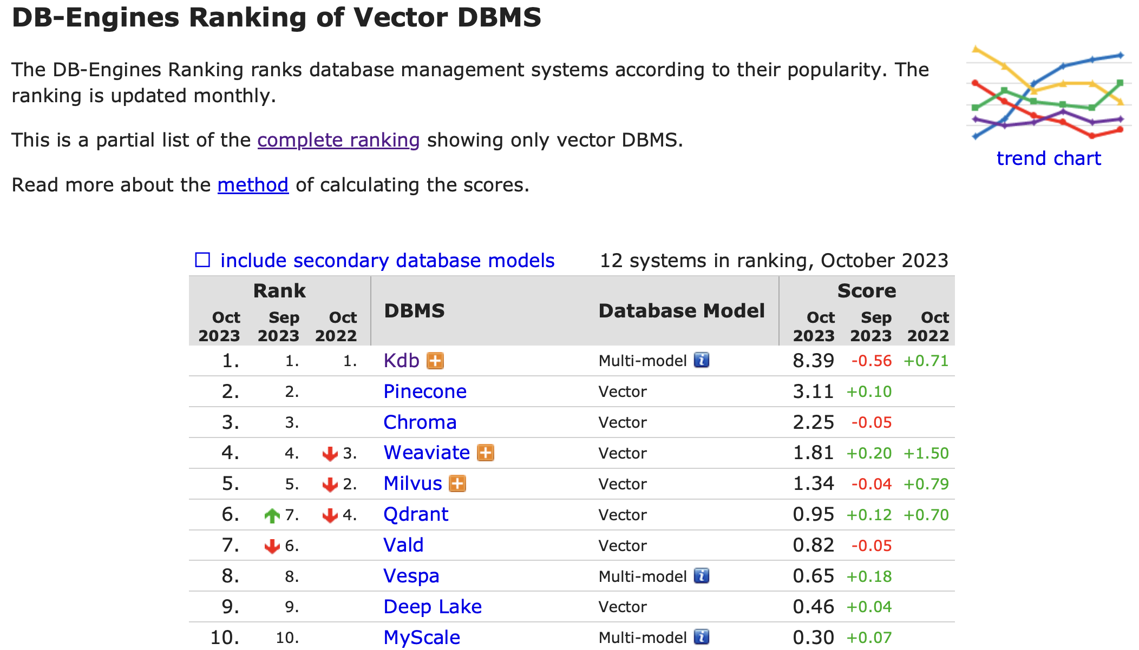
Vector Database

Slide 34
What is a Vector Database?
Embeddings
are generated by AI models (such as Large Language Models) and have a large number of attributes or features, making their representation challenging to manage.
In the context of AI and machine learning,
these features represent different dimensions of the data that are essential for understanding patterns, relationships, and underlying structures.
That is why we need a specialized database designed specifically for handling this type of data.
Vector databases like Pinecone fulfill this requirement by offering optimized storage and querying capabilities for embeddings.

Slide 35
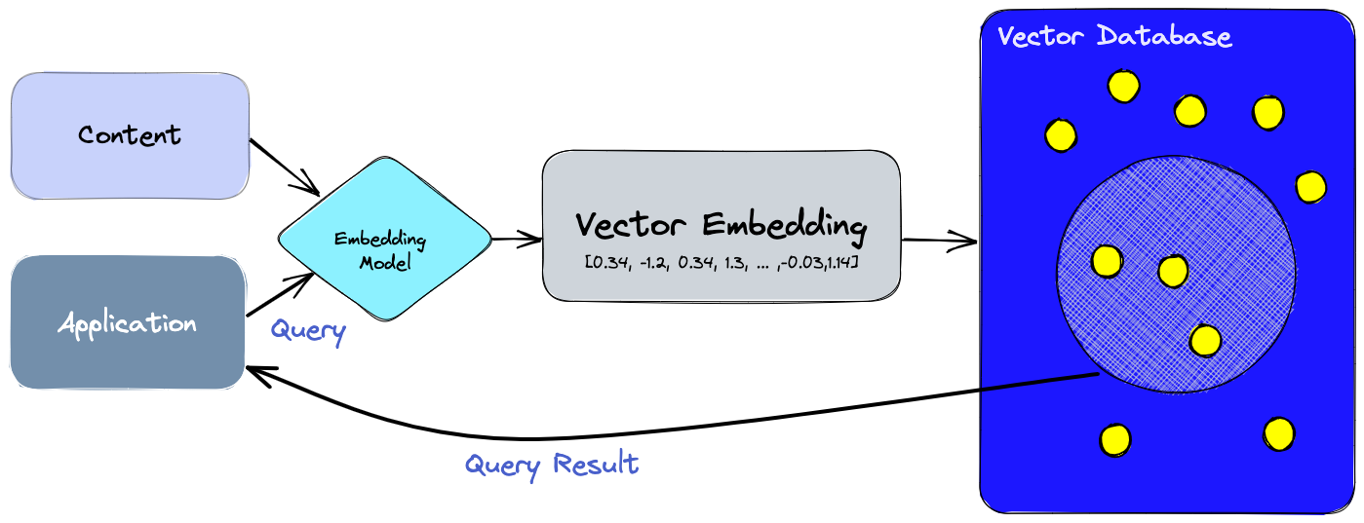
Vector Database
The diagram below gives us a better understanding of the role of vector databases in this type of application:

Slide 36
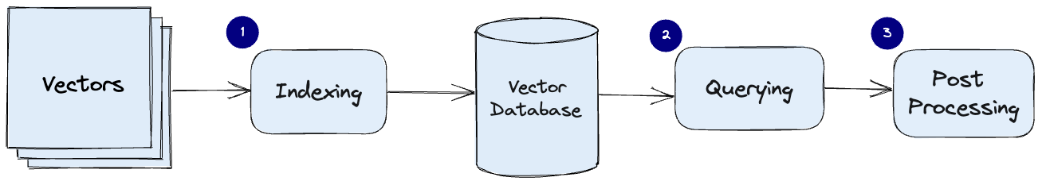
How does a vector database work?
In vector databases, we apply a similarity metric to find a vector that is the most similar to our query.
A vector database uses a combination of different algorithms that all participate in Approximate Nearest Neighbor (ANN) search.
Since the vector database provides approximate results, the main trade-offs we consider are between accuracy and speed.

Slide 37
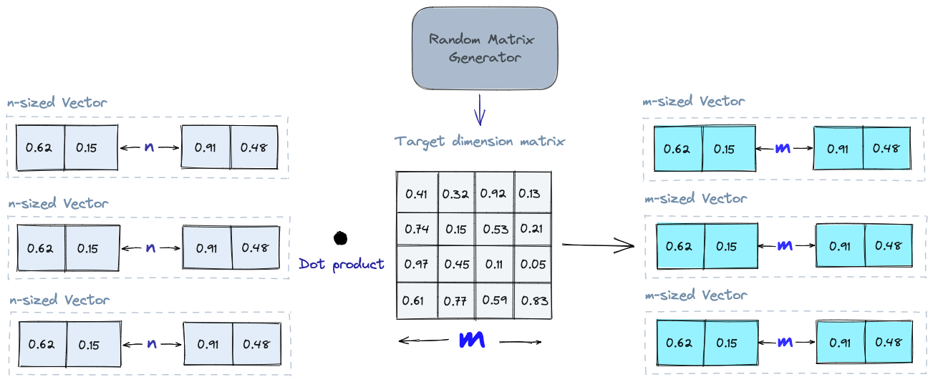
Algorithms
Random Projection
The basic idea behind random projection is to project the high-dimensional vectors to a lower-dimensional space using a random projection matrix.

Slide 38
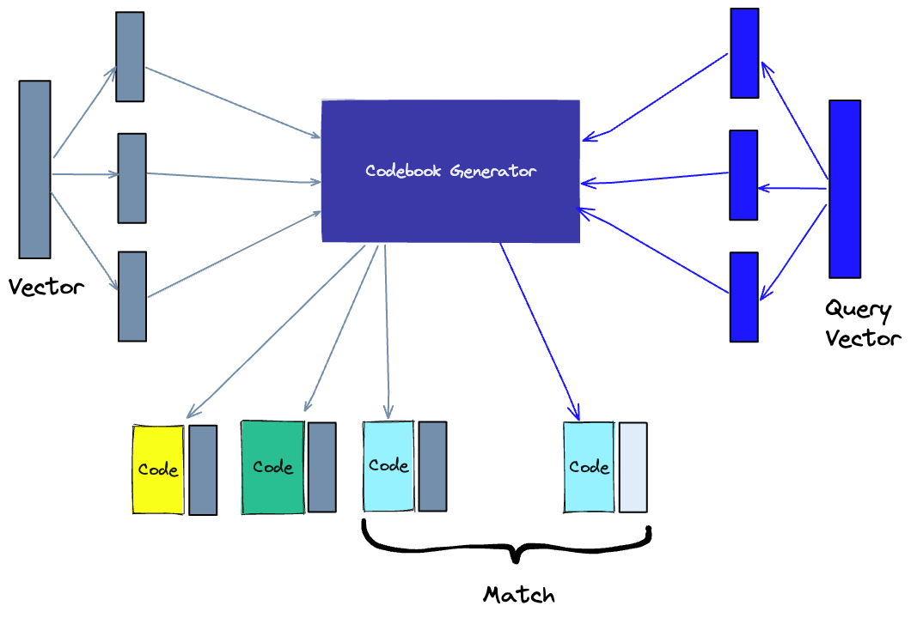
Algorithms
Product Quantization
It takes the original vector, breaks it up into smaller chunks, simplifies the representation of each chunk by creating a representative “code” for each chunk, and then puts all the chunks back together.

Slide 39
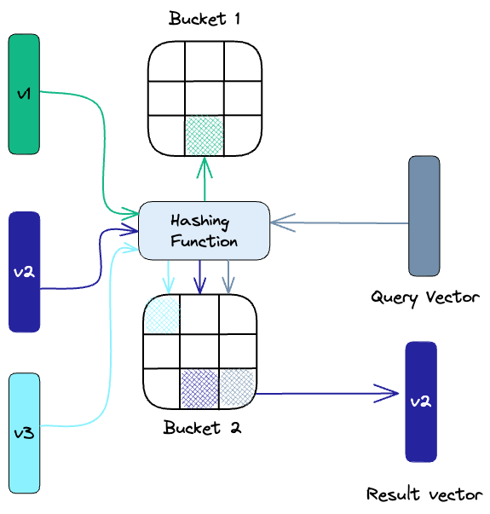
Algorithms
Locality-sensitive hashing
Locality-Sensitive Hashing (LSH) is a technique for indexing in the context of an approximate nearest-neighbor search.

Slide 40
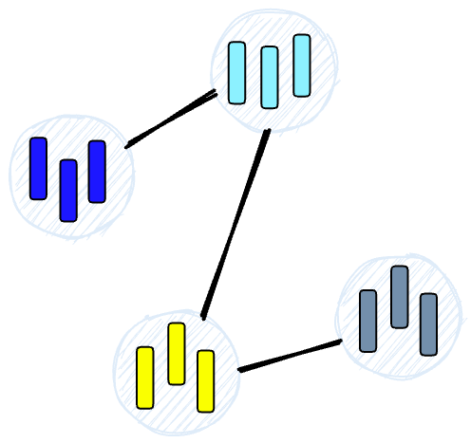
Algorithms
Hierarchical Navigable Small World
Hierarchical Navigable Small World (HNSW) creates a hierarchical, tree-like structure where each node of the tree represents a set of vectors. The edges between the nodes represent the similarity between the vectors.

Slide 41
Similarity Measures
Cosine similarity:
It ranges from -1 to 1, where 1 represents identical vectors, 0 represents orthogonal vectors, and -1 represents vectors that are diametrically opposed.
Euclidean distance:
It ranges from 0 to infinity, where 0 represents identical vectors, and larger values represent increasingly dissimilar vectors.
Dot product:
It ranges from -∞ to ∞, where a positive value represents vectors that point in the same direction, 0 represents orthogonal vectors, and a negative value represents vectors that point in opposite directions.

Slide 42
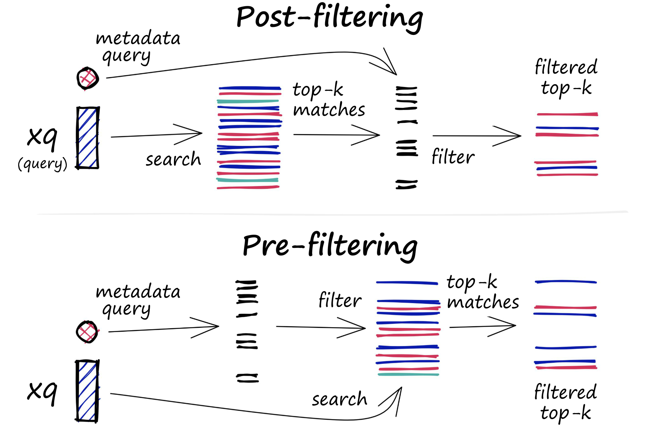
Filtering
Every vector stored in the database also includes metadata.
In addition to the ability to query for similar vectors, vector databases can also filter the results based on a metadata query.
To do this, the vector database usually maintains two indexes: a vector index and a metadata index.

Slide 43
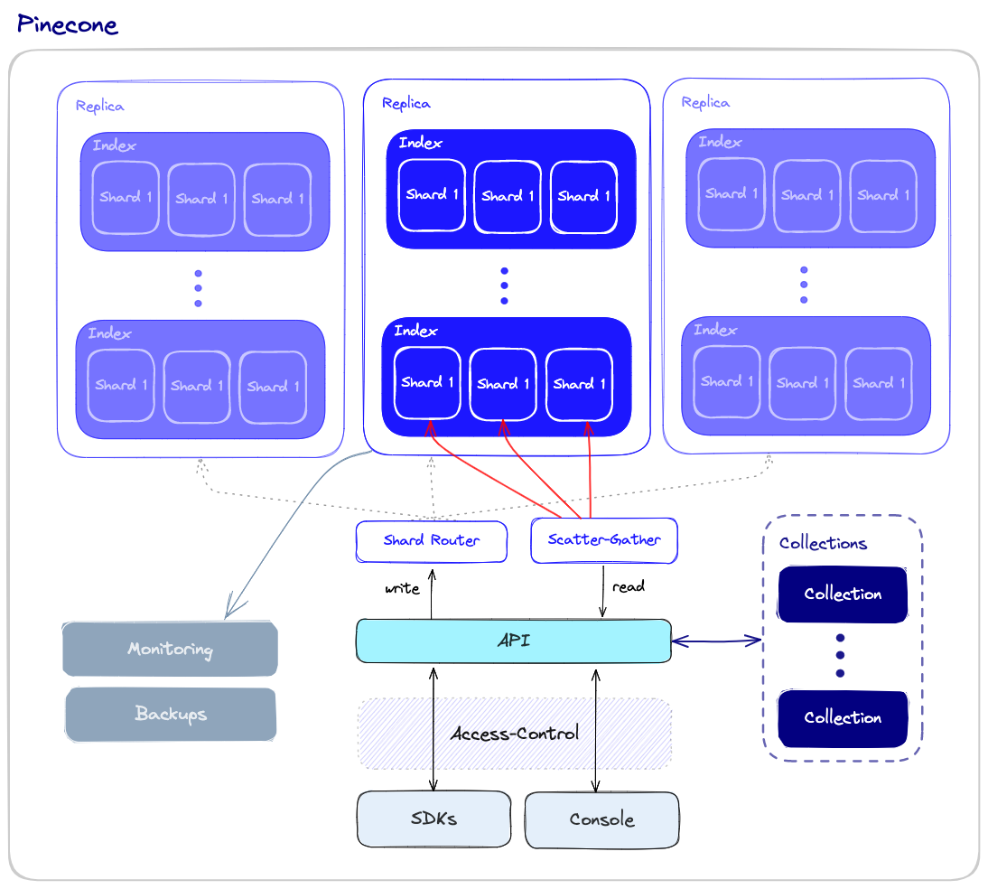
Database Operations

Slide 44
Pinecone
The Pinecone
A vector database makes it easy to build high-performance vector search applications. Developer-friendly, fully managed, and easily scalable without infrastructure hassles.
Install Pinecone Client
Python: pip install pinecone-client
JavaScript: npm install @pinecone-database/pinecone
https://github.com/pinecone-io

Slide 45
Hello, Pinecone!
1. Initialize Pinecone
import pinecone
pinecone.init(api_key="YOUR_API_KEY", environment="YOUR_ENVIRONMENT")
2. Create an index
pinecone.create_index("quickstart", dimension=8, metric="euclidean") pinecone.describe_index("quickstart")
3. Retrieve a list of your indexes
pinecone.list_indexes() # Returns: # ['quickstart’]
4. Create a client instance
index = pinecone.Index("quickstart")

Slide 46
Hello, Pinecone!
5. Insert the data.
# Upsert sample data (5 8-dimensional vectors)
index.upsert([
("A", [0.1, 0.1, 0.1, 0.1, 0.1, 0.1, 0.1, 0.1]),
("B", [0.2, 0.2, 0.2, 0.2, 0.2, 0.2, 0.2, 0.2]),
("C", [0.3, 0.3, 0.3, 0.3, 0.3, 0.3, 0.3, 0.3]),
("D", [0.4, 0.4, 0.4, 0.4, 0.4, 0.4, 0.4, 0.4]),
("E", [0.5, 0.5, 0.5, 0.5, 0.5, 0.5, 0.5, 0.5])
])
6. Get statistics about your index.
index.describe_index_stats()
# Returns:
# {'dimension': 8, 'index_fullness': 0.0, 'namespaces': {'': {'vector_count': 5}}}

Slide 47
Hello, Pinecone!
7. Query the index and get similar vectors.
index.query(
vector=[0.3, 0.3, 0.3, 0.3, 0.3, 0.3, 0.3, 0.3], top_k=3, include_values=True )
# Returns:
# {'matches': [{'id': 'C’,
# 'score': 0.0,
# 'values': [0.3, 0.3, 0.3, 0.3, 0.3, 0.3, 0.3, 0.3]},
# {'id': 'D’,
# 'score': 0.0799999237,
# 'values': [0.4, 0.4, 0.4, 0.4, 0.4, 0.4, 0.4, 0.4]},
# {'id': 'B’,
# 'score': 0.0800000429,
# 'values': [0.2, 0.2, 0.2, 0.2, 0.2, 0.2, 0.2, 0.2]}],
# 'namespace': ''}

Slide 48
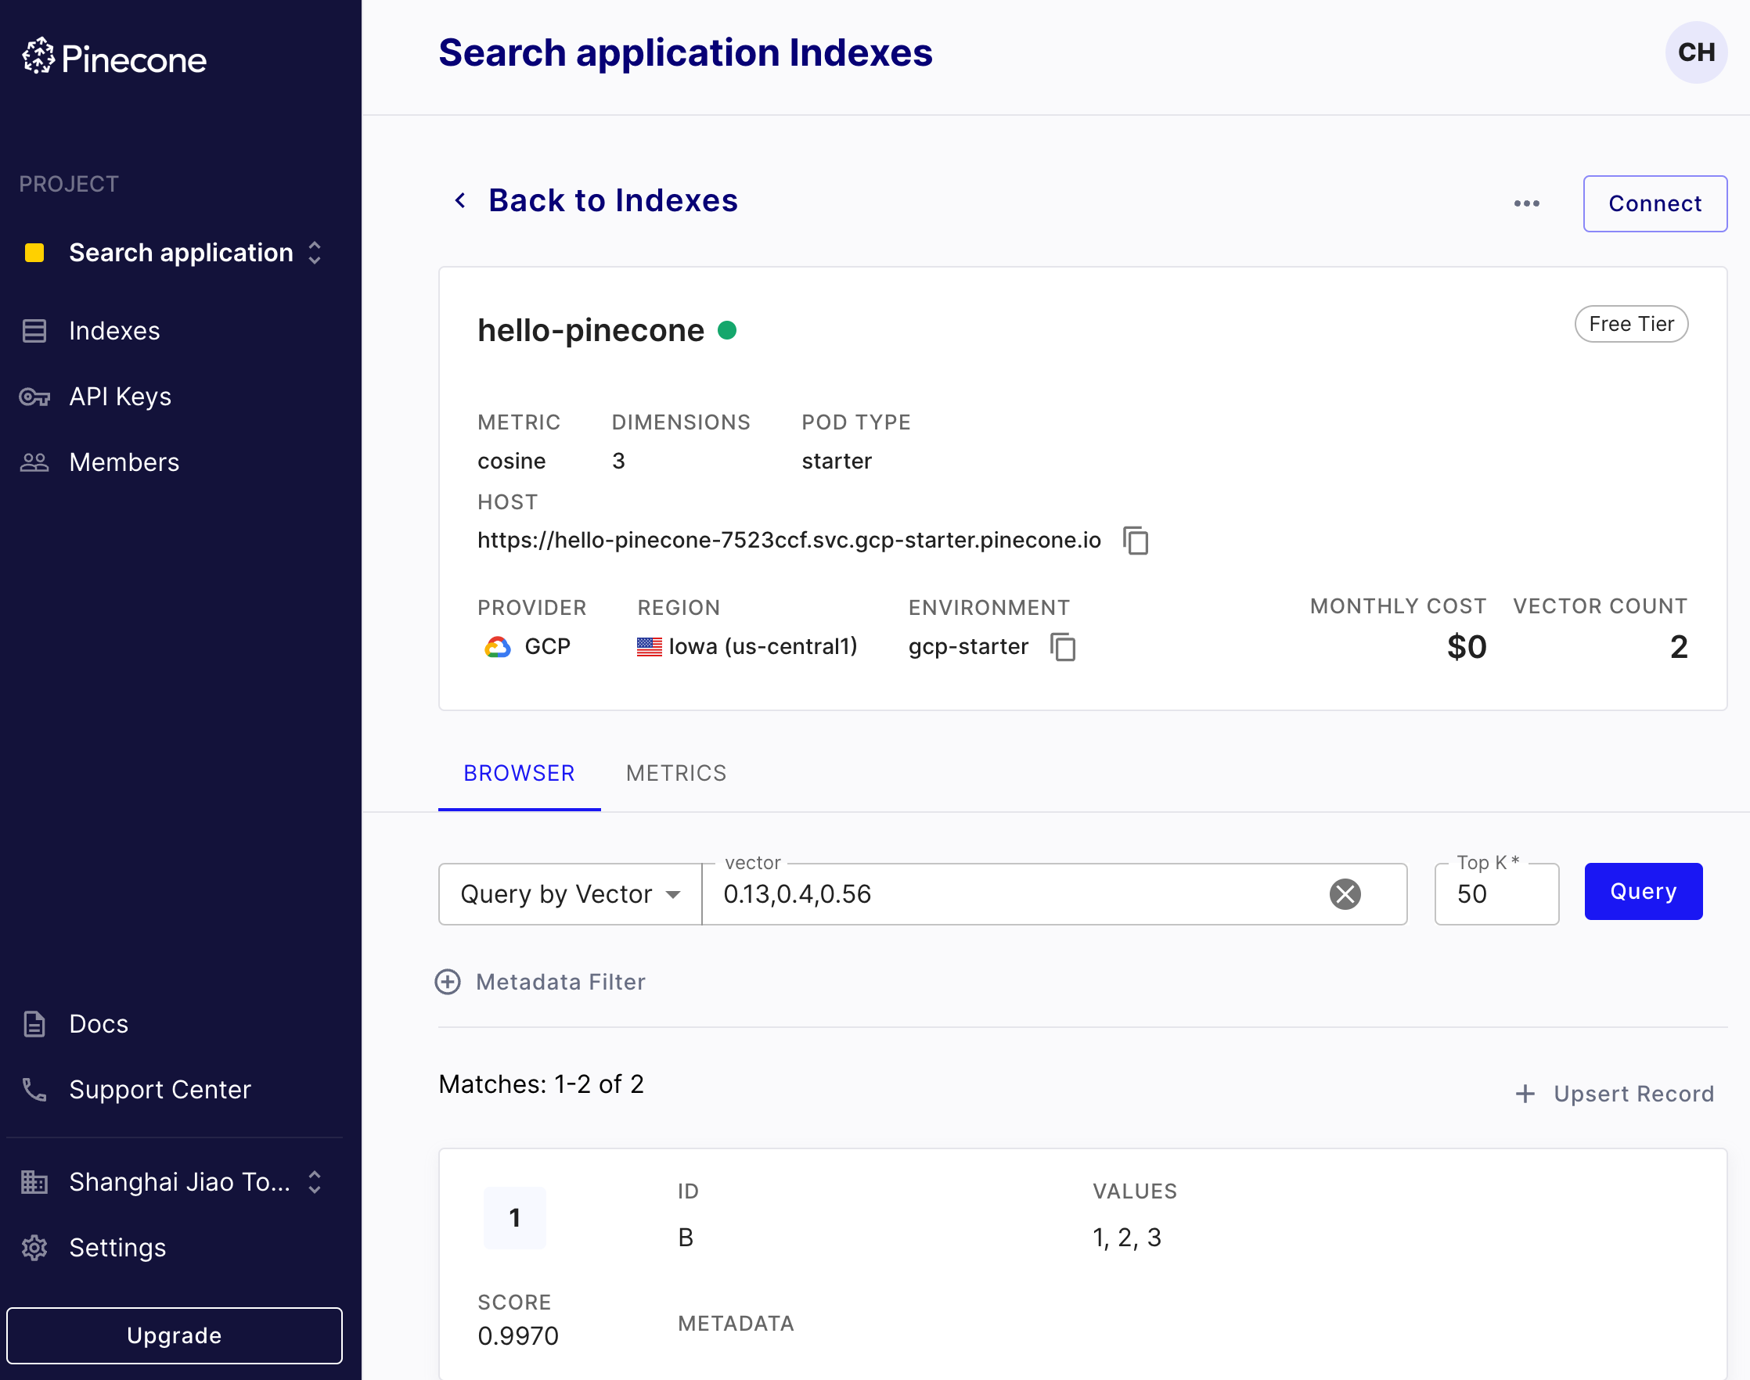
Hello, Pinecone!
8. Delete the index.
pinecone.delete_index("quickstart")
https://app.pinecone.io/

Slide 49
References
Roie Schwaber-Cohen: What is a Vector Database?
https://archive.pinecone.io/learn/vector-database/
Pinecone
https://archive.pinecone.io/
https://docs.pinecone.io/
Pinecone Java Client
https://github.com/pinecone-io/pinecone-java-client
Integrating Pinecone Vector Database into a Spring Boot Application
https://hilla.dev/blog/ai-chatbot-in-java/integrating-pinecone-vector-database-into-spring-boot/
https://github.com/marcushellberg/docs-assistant

Slide 50

Thank You!

